Slide 1
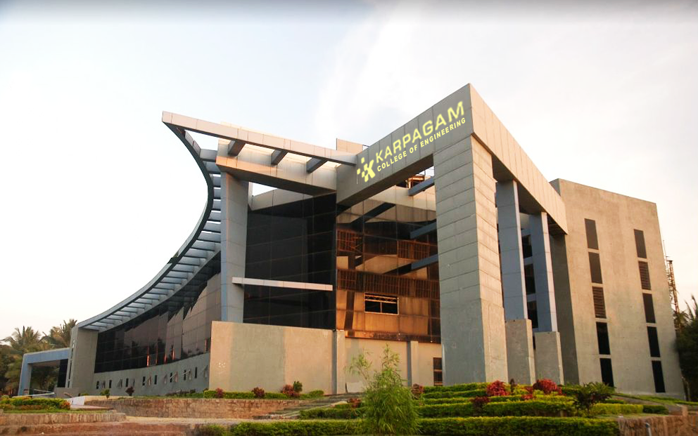

Detecting Offensive Language in Tamil YouTube Comments
Jishnu B 20P122
Suwinkumar T 20P156
Tanush K 20P157
Udhayarajan M 20P158
Mentor:
Dr. S. Arul Antran Vijay, ASP CSE

Slide 2
ABSTRACT:
In the expanding field of online content moderation, the task of identifying offensive language in multilingual social media environments poses a significant challenge.
This research presents a comparative analysis of five advanced BERT models – mBERT, BERT Base and Large, DistilBERT, and RoBERTa – specifically focusing on detecting offensive language in Tamil YouTube comments.
This research delves into the nuanced processing capabilities of these models, tailored to address the complexities of Tamil, a language rich in dialects and colloquialisms. Whisper AI serves as a pivotal component for enriching offensive language detection on Tamil Contents on YouTube. By integrating Whisper AI for audio-to-text conversion, the project augments its capabilities by extracting textual content from audio inputs
We outline our methodology, which involves meticulous data collection, preprocessing tailored to the Tamil language, and fine-tuning each model on a substantial dataset of Tamil YouTube comments.

Slide 3
INTRODUCTION
The Challenge of Online Content Moderation :
In the digital era, social media platforms have become ubiquitous, serving as primary channels for communication and content sharing.
Alongside their rapid growth, these platforms have increasingly grappled with the challenge of moderating content, particularly in regulating offensive language.
The presence of such language can have a detrimental impact on users, fostering toxic online environments and necessitating effective moderation tools.
The nuances of Tamil, encompassing colloquialisms, slang, and regional variations, make the task of detecting offensive content particularly challenging.
The social media harmful not only propagates through text but media, images as well.

Slide 4
INTRODUCTION (continued)
BERT Models and Language-Specific Adaptation:
Among the various NLP models, BERT (Bidirectional Encoder Representations from Transformers) and its variants have shown great promise in understanding and processing natural language.
Originally developed and pre-trained in English, these models have been adapted for multilingual purposes.
However, their effectiveness in handling specific languages like Tamil, particularly for tasks such as offensive language detection, has not been extensively explored.
This research aims to bridge this gap by conducting a comprehensive comparative analysis of several BERT models, including mBERT, BERT Base and Large, DistilBERT, and RoBERTa, specifically for Tamil language processing.

Slide 5
RELATED WORKS
The identification and moderation of offensive language in online platforms, particularly in social media, have been significant areas of research within computational linguistics and artificial intelligence.
This research presents a review of the literature concerning the detection of offensive language, the development and evolution of BERT models, and their application in the context of multilingual natural language processing, with a specific focus on the Tamil language.

Slide 6
RELATED WORKS (continued)
Offensive Language Detection:
The detection of offensive language in digital communication platforms has been a long-standing challenge.
Initially, research in this area focused on developing lexicon-based methods that relied on predefined lists of offensive words and phrases.
However, these methods often proved inadequate due to their inability to understand the context and evolving nature of language use.
With the advent of machine learning and deep learning techniques, more sophisticated approaches were developed.

Slide 7
RELATED WORKS (continued)
Evolution of BERT Models:
The introduction of BERT (Bidirectional Encoder Representations from Transformers) marked a significant advancement in natural language processing.
BERT’s transformer architecture, which allows it to understand the context of words in a sentence, significantly improved the performance of models in a variety of natural language processing tasks.
Following BERT’s success, several variants were developed.
These include RoBERTa, which modifies the BERT pretraining procedure for improved performance, and DistilBERT, a smaller and faster version that retains most of BERT’s capabilities.

Slide 8
RELATED WORKS (continued)
Multilingual Models and Language-Specific Challenges:
BERT’s initial development in English led to its extension to multilingual contexts.
Models such as mBERT and XLM-R were trained in numerous languages, enabling cross-lingual understanding.
Issues such as limited training data and the need for language-specific adaptations are critical in ensuring the effectiveness of these models in diverse linguistic settings.

Slide 9
RESEARCH OBJECTIVES
The primary objective of this research is to address the challenge of detecting offensive language in Tamil YouTube comments using advanced natural language processing (NLP) techniques.
Despite the rapid growth of online content and the increasing need for effective moderation tools, there is a notable gap in the development of NLP models that can accurately identify offensive language in Tamil, a language rich in dialects and colloquialisms.
Our research aims to fill this gap by evaluating and comparing the performance of various BERT (Bidirectional Encoder Representations from Transformers) models, including mBERT, BERT Base and Large, DistilBERT, and RoBERTa.
These models, known for their effectiveness in language understanding and processing, have not been extensively tested for Tamil language content, especially in the context of offensive language detection.
In addition, to this we have implemented audio to text conversion for Youtube Shorts and Videos using Whisper AI for enriching the offensive language detection process.

Slide 10
METHODOLOGY
This research’s methodology is structured to systematically compare the effectiveness of various BERT models in detecting offensive language in Tamil YouTube comments.
Our approach encompasses:
Data collection
Preprocessing
Model adaptation
Training
Evaluation

Slide 11
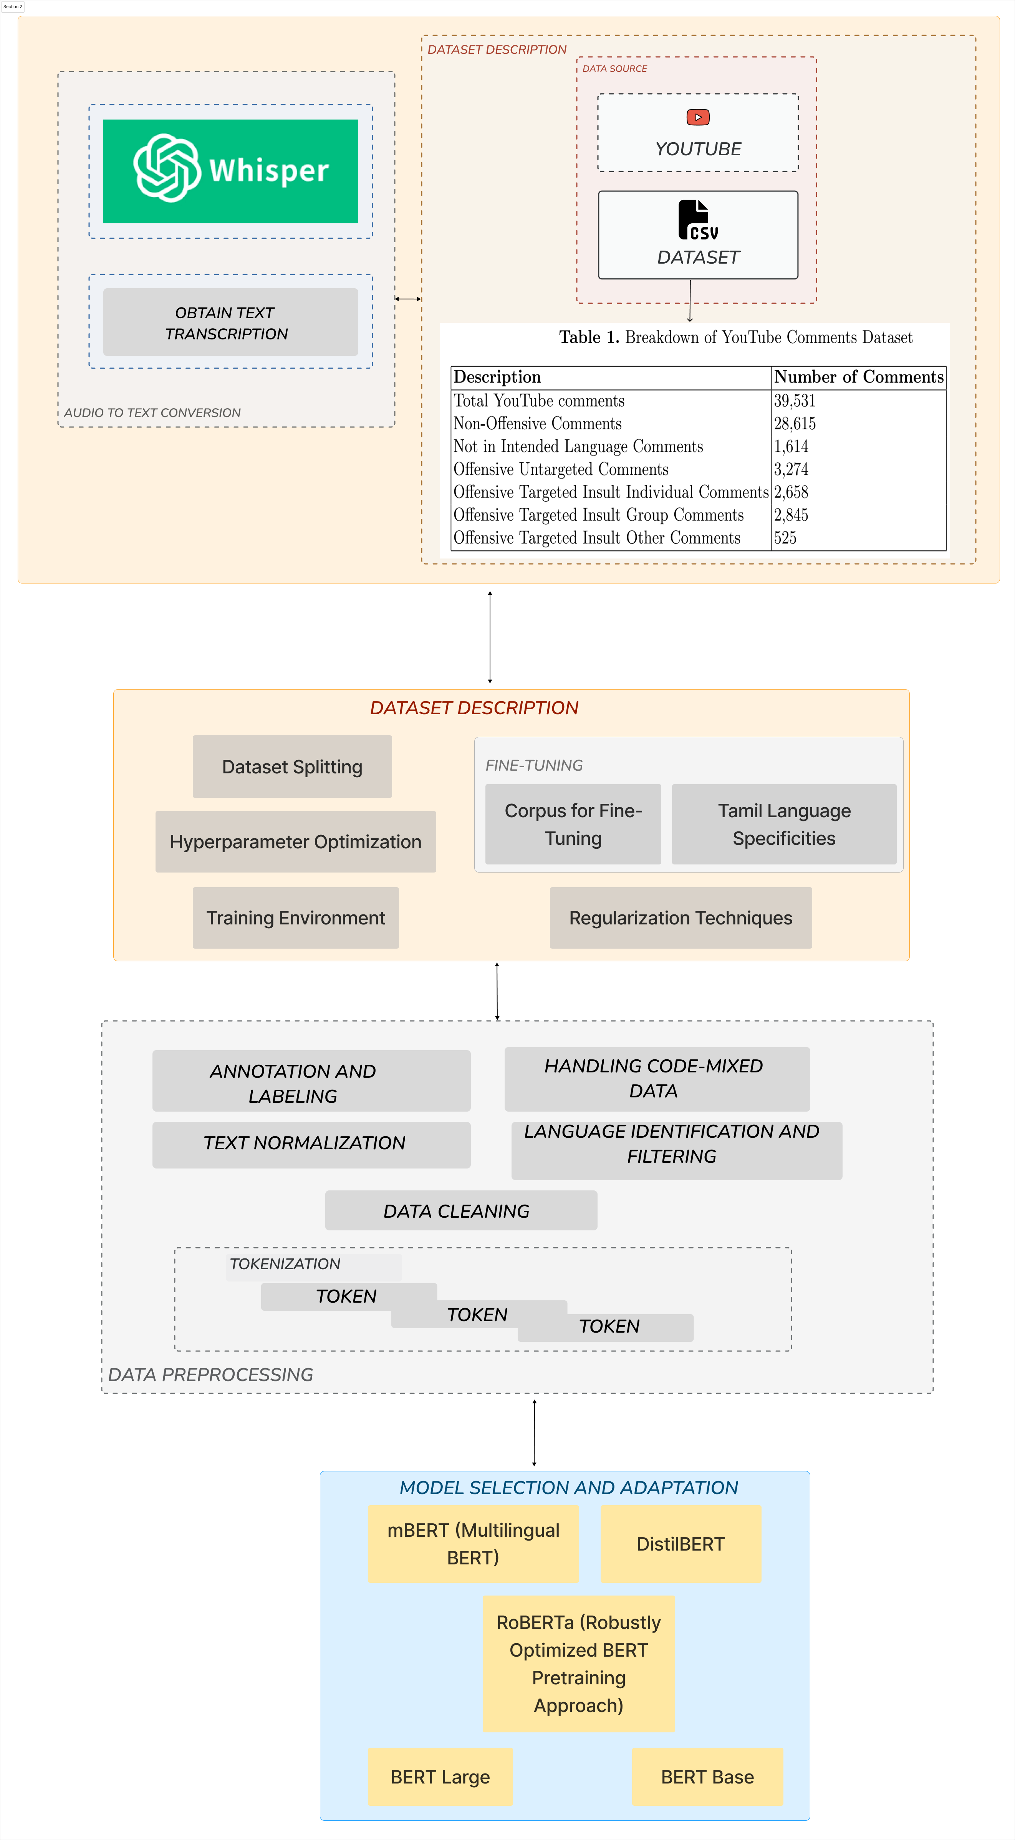
SYSTEM ARCHITECTURE

Slide 12
DATA DESCRIPTION
In the realm of online media, platforms such as Twitter, Facebook, and YouTube host rapidly evolving content from millions of users, impacting the reputations of individuals and organizations.
YouTube, particularly popular in the Indian subcontinent, offers a diverse array of content including songs, tutorials, product reviews, and movie trailers, making it a fertile ground for data collection.
Description | Number of Comments
Total Youtube Comments | 39,531
Non-Offensive Comments | 28,615
Not in Intended Language Comments | 1,614
Offensive Untargeted Comments | 3,274
Offensive Targeted Insult Individual Comments | 2,658
Offensive Targeted Insult Group Comments | 2,845
Offensive Targeted Insult Other Comments | 525
Table 1. Breakdown of YouTube Comments Dataset

Slide 13
AUDIO DATA DESCRIPTION
YouTube, particularly popular in the Indian subcontinent, offers a diverse array of content including songs, tutorials, product reviews, and movie trailers, making it a fertile ground for data collection.
Description | Number of Comments
Data Collected | 1014
Non - Offensive Comments | 328
Offensive Untargeted Comments | 256
Offensive Targeted Insult Individual Comments | 183
Offensive Targeted Insult Group Comments | 140
Offensive Targeted Insult Other Comments | 108
Table 1. Breakdown of YouTube Audio Dataset

Slide 14
DATA PREPROCESSING
The preprocessing of the Tamil YouTube comments dataset involved several key steps to ensure its readiness for analysis:
Data Cleaning: Removal of irrelevant content (URLs, hashtags, user mentions) and non-Tamil characters using Regular Expressions and custom scripts.
2. Language Identification and Filtering: Application of language detection tools to retain only Tamil comments, ensuring linguistic focus.
3. Text Normalization: Standardization of the text format, including lowercasing and normalizing colloquial terms, to reduce complexity.

Slide 15
DATA PREPROCESSING (continued)
Tokenization: Segmenting text into tokens using a custom Tamil tokenizer, addressing the language’s unique morphological challenges.
5. Handling Code-Mixed Data: Implementing specific techniques for processing comments that mix Tamil with English, preserving linguistic characteristics.
6. Annotation and Labeling: Manually annotating each comment as offensive or non-offensive by linguistic experts, creating a reliable dataset for supervised learning.

Slide 16
MODEL SELECTION AND ADAPTATION
We chose five distinct models, each offering unique capabilities and strengths in natural language processing:
mBERT (Multilingual BERT): A variant of BERT trained on a large corpus of multiple languages. mBERT’s multilingual capabilities make it a suitable choice for analyzing the Tamil language, which often involves codeswitching and the use of mixed languages.
BERT Base: The standard BERT model with a base configuration. It serves as a benchmark for performance comparison and is known for its effectiveness in language understanding.
BERT Large: An upscaled version of BERT with more layers and parameters, offering deeper linguistic analysis, which is beneficial for capturing the nuances of Tamil.

Slide 17
MODEL SELECTION AND ADAPTATION (continued)
DistilBERT: A distilled version of BERT that retains most of the original model’s effectiveness but is smaller and faster, making it efficient for processing large datasets like YouTube comments.
RoBERTa (Robustly Optimized BERT Pretraining Approach): An optimized version of BERT, trained with a modified pretraining approach that improves its performance, particularly in understanding context and semantics.

Slide 18
MODEL TRAINING
The training phase for the selected BERT models—mBERT, BERT Base, BERT Large, DistilBERT, and RoBERTa—is a crucial component of our research. This phase involves the following key steps:
Dataset Splitting
Fine-Tuning
Hyperparameter Optimization
Training Environment
Regularization Techniques

Slide 19
MODEL TRAINING (continued)
Table 2. Division of Dataset into Training, Validation, and Testing
The table categorizes YouTube comments into seven categories based on their content. These categories include total comments, non-offensive comments, comments not in the intended language, and various types of offensive comments
Each category is further divided into three datasets: Training, Validation, and Testing. The numbers represent the count of comments in each category for each dataset.
Dataset Category | Training | Validation | Testing
Total Youtube Comments | 27,573 | 5,958 | 6,000
Non-Offensive Comments | 20,030 | 4,292 | 4,293
Not in Intended Language Comments | 1,130 | 242 | 242
Offensive Untargeted Comments | 2,291 | 491 | 492
Offensive Targeted Insult IndividuśSal Comments | 1,861 | 398 | 399
Offensive Targeted Insult Group Comments | 1,990 | 427 | 428
Offensive Targeted Insult Other Comments | 368 | 108 | 49

Slide 20
MODEL TRAINING (continued)
Table 3. Hyperparameters for BERT Models
These steps collectively ensure that the BERT models are adequately prepared and optimized for the task of detecting offensive language in Tamil YouTube comments, contributing to the reliability and accuracy of our research.
S.No | BERT Model | Learning Rate | Batch Size | Description of Parameters
1 | mBert | 0.0001 | 32 | Multilingual BERT model fine-tuned for Tamil offensive language detection. Learning rate set to 0.0001 for optimal convergence.
2 | BERT Base | 0.0003 | 16 | BERT Base model adapted for Tamil language with a learning rate of 0.0003 for effective training.
3 | BERT Large | 0.0002 | 8 | BERT Large model fine-tuned for Tamil offensive language detection. Utilizes a smaller batch size of 8 for memory efficiency
4 | DistilBERT | 0.0002 | 32 | DistilBERT model optimized for Tamil offensive content identification. Learning rate set to 0.0002 for convergence.
5 | RoBERTa | 0.0003 | 16 | RoBERTa model tailored for Tamil language processing with a learning rate of 0.0003 for efficient training.

Slide 21
PERFORMANCE EVALUATION
Evaluation Metrics:
Accuracy: Accuracy is a fundamental metric that measures the overall correctness of the model’s predictions. It is calculated as the ratio of correctly classified instances to the total number of instances in the dataset.
Precision: Precision quantifies the ability of the model to make correct positive predictions. It is the ratio of true positive predictions to the total number of positive predictions made by the model
Recall: Recall, also known as sensitivity, measures the model’s ability to identify all actual positive instances. It is calculated as the ratio of true positive predictions to the total number of actual positive instances.

Slide 22
PERFORMANCE EVALUATION (continued)
F1-Score: The F1-Score is the harmonic mean of precision and recall. It provides a balance between precision and recall and is particularly useful when dealing with imbalanced datasets
Specificity: In addition to the above-mentioned metrics, we also considered specificity, which quantifies the ability of the model to correctly identify negative instances. It is calculated as

Slide 23
RESULT AND ANALYSIS
The final stage of our methodology involves a comparative analysis of the performance of each BERT model.
Through this methodological approach, our research aims to provide an in-depth understanding of how different BERT models perform in the context of Tamil language processing and offer insights into the most effective models for this specific application.
Model | Accuracy | Precision | Recall | F1-Score | Specificity
mBERT | 0.85 | 0.88 | 0.80 | 0.84 | 0.90
BERT Base | 0.86 | 0.89 | 0.82 | 0.85 | 0.91
BERT Large | 0.87 | 0.90 | 0.84 | 0.87 | 0.92
DistilBERT | 0.84 | 0.87 | 0.79 | 0.83 | 0.89
RoBERTa | 0.88 | 0.91 | 0.86 | 0.88 | 0.93
Table 4. Performance Comparison of BERT Models for Offensive Tamil Dataset

Slide 24
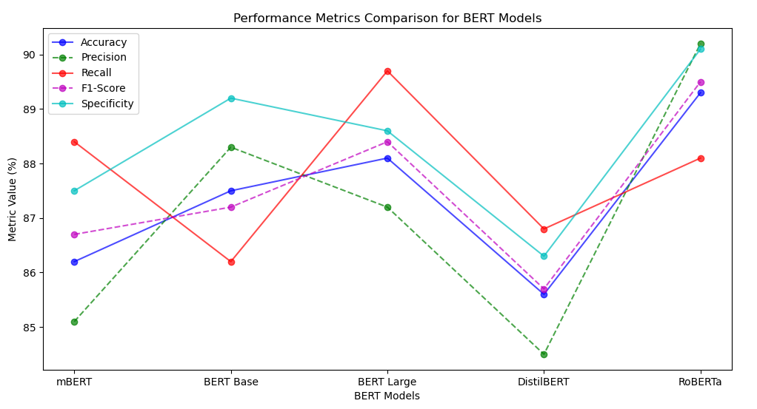
RESULT AND ANALYSIS (continued)
To evaluate the performance of each model, we used metrics such as accuracy, precision, recall, F1-score, and specificity. These metrics provide a comprehensive understanding of each model’s ability to correctly identify offensive language in Tamil YouTube comments.
Fig. 1. Performance Metrics Comparison for BERT Models

Slide 25
CONCLUSION
In this research, we conducted a comprehensive analysis of five BERT models, namely mBERT, BERT Base, BERT Large, DistilBERT, and RoBERTa, for the task of offensive language detection in Tamil YouTube comments.
Whisper AI for audio-to-text conversion provided additional context, enriching the offensive language detection process.
The findings of this research shed light on the strengths and limitations of each model, providing valuable insights for offensive language detection in Tamil and similar languages.
RoBERTa, fine-tuned specifically for Tamil, demonstrated superior performance in offensive language detection, achieving the highest accuracy and precision.
BERT Large, despite its computational demands, exhibited enhanced accuracy and recall, making it suitable for applications where high accuracy is paramount.
DistilBERT, a memory-efficient model, offered a practical compromise between performance and computational resources, making it suitable for resource-constrained environments

Slide 26
CONCLUSION (continued)
mBERT showcased its multilingual efficacy, performing reasonably well in detecting offensive language in Tamil comments, highlighting its versatility. BERT Base, while resource-intensive, delivered solid performance and can be a viable choice for well-resourced applications.
In summary, RoBERTa performed exceptionally well across all metrics, making it a top choice for offensive language detection in Tamil YouTube comments.
BERT Large and BERT Base also showed strong performance, while mBERT and DistilBERT provided competitive results.
The choice of the model may depend on the specific requirements and trade-offs between precision and recall in the application.

Slide 27
REFERENCES
Chakravarthi, B.R., Priyadharshini, R., Banerjee, S., Jagadeeshan, M.B., Kumaresan, P.K., Ponnusamy, R., Benhur, S., McCrae, J.P.: Detecting abusive comments at a fine-grained level in a low-resource language. In: Natural Language Processing Journal, vol. 3, p. 100006 (2023), Elsevier.
Saleh, H., Alhothali, A., Moria, K.: Detection of hate speech using BERT and hate speech word embedding with deep model. In: Applied Artificial Intelligence, vol. 37, no. 1, p. 2166719 (2023), Taylor & Francis.
Mazari, A.C., Boudoukhani, N., Djeffal, A.: BERT-based ensemble learning for multi-aspect hate speech detection. In: Cluster Computing, pp. 1-15 (2023), Springer.
Khan, A.A., Iqbal, M.H., Nisar, S., Ahmad, A., Iqbal, W.: Offensive Language Detection for Low Resource Language Using Deep Sequence Model. In: IEEE Transactions on Computational Social Systems (2023), IEEE.
Quoc Tran, K., Trong Nguyen, A., Hoang, P.G., Luu, C.D., Do, T.-H., Van Nguyen, K.: Vietnamese hate and offensive detection using PhoBERT-CNN and social media streaming data. In: Neural Computing and Applications, vol. 35, no. 1, pp. 573-594 (2023), Springer.

Slide 28
REFERENCES (continued)
Anand, M., Sahay, K.B., Ahmed, M.A., Sultan, D., Chandan, R.R., Singh, B.: Deep learning and natural language processing in computation for offensive language detection in online social networks by feature selection and ensemble classification techniques. In: Theoretical Computer Science, vol. 943, pp. 203-218 (2023), Elsevier.
Saeed, R., Afzal, H., Rauf, S.A., Iltaf, N.: Detection of Offensive Language and ITS Severity for Low Resource Language. In: ACM Transactions on Asian and Low-Resource Language Information Processing, vol. 22, no. 6, pp. 1-27 (2023), ACM New York, NY.
Priyadharshini, R., Chakravarthi, B.R., Malliga, S., Subalalitha, C.N., Kogilavani, S.V., Premjith, B., Murugappan, A., Kumaresan, P.K.: Overview of shared-task on abusive comment detection in tamil and telugu. In: Proceedings of the Third Workshop on Speech and Language Technologies for Dravidian Languages, pp. 80-87 (2023).
Shanmugavadivel, K., Subramanian, M., Srigha, S., JS, Sree Harene, and others: KEC_AI_NLP@ DravidianLangTech: Abusive Comment Detection in Tamil Language. In: Proceedings of the Third Workshop on Speech and Language Technologies for Dravidian Languages, pp. 293-299 (2023).

Slide 29
REFERENCES (continued)
Palanikumar, V., Mohan, M., Shanmugavadivel, K.: Development of Multi-lingual Models for Detecting Hope Speech Texts from Social Media Comments. In: Speech and Language Technologies for Low-Resource Languages: First International Conference, SPELLL 2022, Kalavakkam, India, November 23–25, 2022, Proceedings, p. 209 (2023), Springer Nature.
Chakravarthi, B.R., Jagadeeshan, M.B., Palanikumar, V., Priyadharshini, R.: Offensive language identification in dravidian languages using MPNet and CNN. In: International Journal of Information Management Data Insights, vol. 3, no. 1, p. 100151 (2023), Elsevier.
Barman, S., Das, M.: hate-alert@ DravidianLangTech: Multimodal Abusive Language Detection and Sentiment Analysis in Dravidian Languages. In: Proceedings of the Third Workshop on Speech and Language Technologies for Dravidian Languages, pp. 217-224 (2023).
Balakrishnan, V., Govindan, V., Govaichelvan, K.N.: Tamil Offensive Language Detection: Supervised versus Unsupervised Learning Approaches. In: ACM Transactions on Asian and Low-Resource Language Information Processing, vol. 22, no. 4, pp. 1-14 (2023), ACM New York, NY.

Slide 30
REFERENCES (continued)
Divya, S., Sripriya, N.: Transformer based model for offensive content recognition in dravidian languages. In: Brazilian Journal of Development, vol. 9, no. 12, pp. 30656-30667 (2023).
Paul, A., Nayyar, A., and others: A context-sensitive multi-tier deep learning framework for multimodal sentiment analysis. In: Multimedia Tools and Applications, pp. 1-30 (2023), Springer.
Abeera, V.P., Kumar, S., Soman, K.P.: Social Media Data Analysis for Malayalam YouTube Comments: Sentiment Analysis and Emotion Detection using ML and DL Models. In: Proceedings of the Third Workshop on Speech and Language Technologies for Dravidian Languages, pp. 43-51 (2023).
Chakravarthi, B.R., Priyadharshini, R., Muralidaran, V., Jose, N., Suryawanshi, S., Sherly, E., McCrae, J.P.: DravidianCodeMix: Sentiment Analysis and Offensive Language Identification Dataset for Dravidian Languages in Code-Mixed Text. In: Language Resources and Evaluation, Springer.

Slide 31
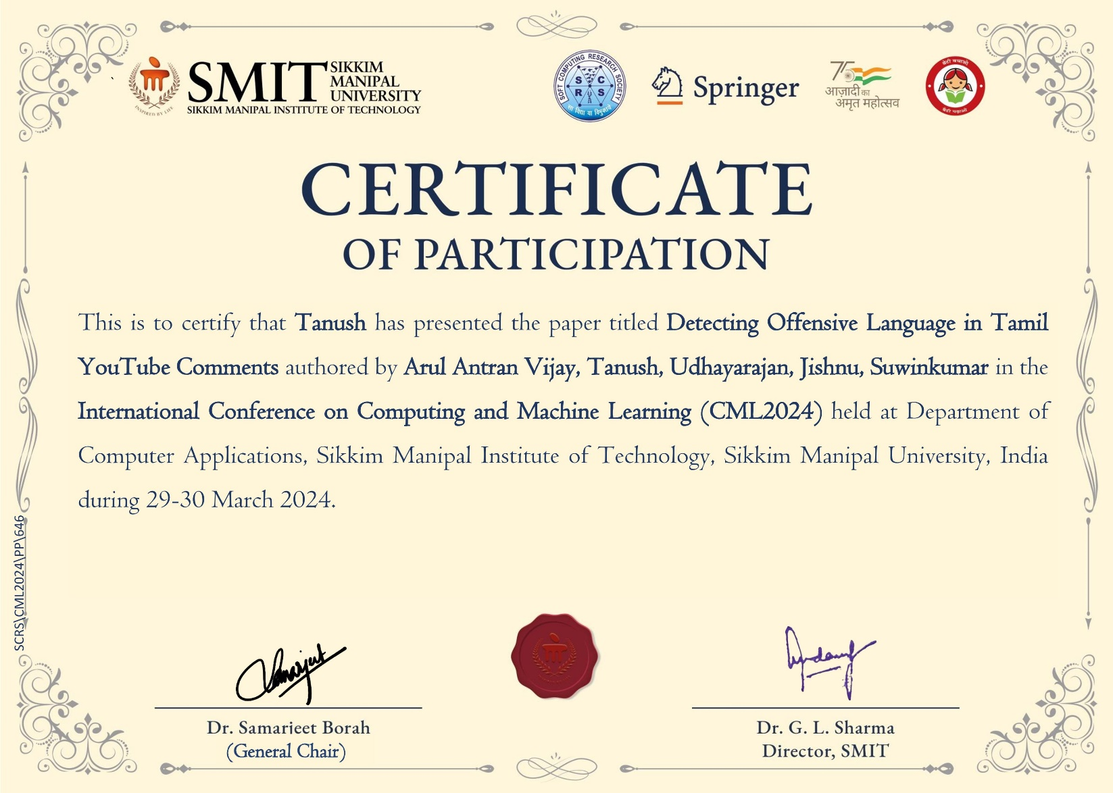
CONFERENCE CERTIFICATE:

Slide 32
THANK YOU

